Slide 1
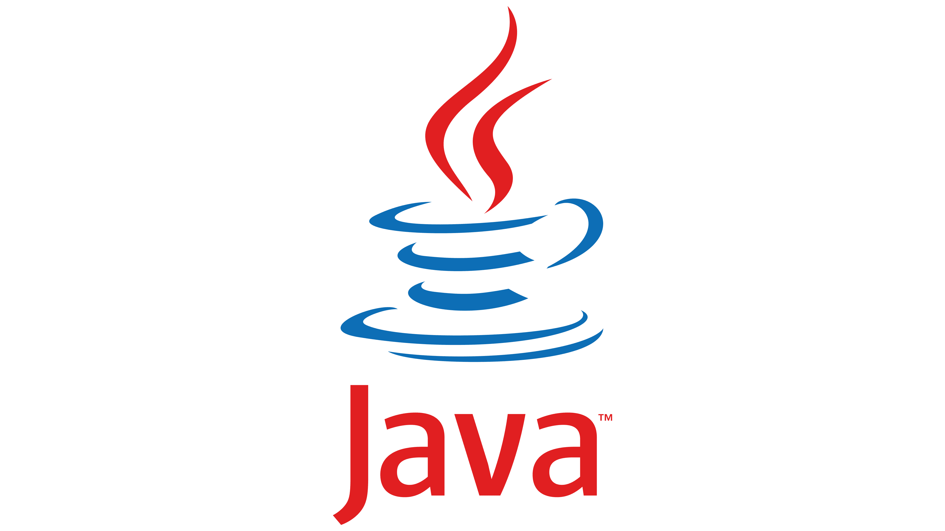
Java

Slide 2
What is Java?
Java is an object-oriented programming language used in distributed environments on the internet.
It is a high-level language that is also easy to read and understand. With it, developers can “write once, run anywhere” (WORA), meaning that the compiled Java code will run on all Java-compatible platforms without the need for recompilation.

Slide 3
History of Java
James Gosling and Sun Microsystems invented the Java programming language in 1991. He had a single motto while creating the language: “Write once; run anywhere.”
They first named this language Oak because of the oak tree outside Gosling’s office. Later, the name changed to Green, then to Java Coffee, which was named after the coffee from Indonesia, and eventually shortened to Java in 1995.

Slide 4
What is Java Used For?
Java is widely used in web consoles, GUIs, web and mobile applications, game development, embedded systems, and desktop applications.
Apart from these, Java is also used to develop software for devices. It is used not only in computers and mobile devices, but even in electronic devices like televisions, air conditioners, washing machines, and so on.
Online registration forms, banking apps, and shopping via the internet are all possible because of Java.

Slide 5
What is Java-Based Upon?
Java is based on C and C++. The first Java compiler was developed by Sun Microsystems and was written in C using some libraries from C++.
Java files are converted to bit code format using a compiler that the Java interpreter then executes. Java code runs on Java Virtual Machine (JVM)—the runtime environment.

Slide 6
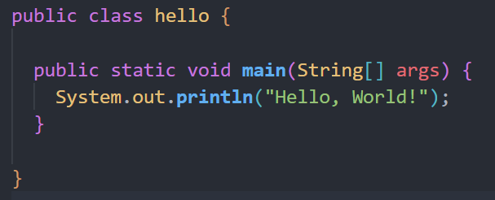
Hello, World!

Slide 7
Java Naming Convention
Java naming convention is a rule to follow as you decide what to name your identifiers such as class, package, variable, constant, method, etc.
But, it is not forced to follow. So, it is known as convention not rule. These conventions are suggested by several Java communities such as Sun Microsystems and Netscape.
All the classes, interfaces, packages, methods and fields of Java programming language are given according to the Java naming convention. If you fail to follow these conventions, it may generate confusion or erroneous code.

Slide 8

CamelCase in Java naming conventions
Java follows camel-case syntax for naming the class, interface, method, and variable.
If the name is combined with two words, the second word will start with uppercase letter always such as actionPerformed(), firstName, ActionEvent, ActionListener, etc.

Slide 9
Congratulations !! on your first java program

Slide 10
Java Concept and Features

Slide 11
Java Concepts

Slide 12
Object
Object is an element or an entity that has a state and behavior.
For example, a dog can be considered an object with a color, a breed, and a name.
It has behaviors such as barking and eating.

Slide 13
Class
A class is a collection of multiple objects. It is a blueprint that can be used to create as many objects as you like.
Classes are used to organize code, just like how fruits, vegetables, and clinical products are divided into different sections in a supermarket.

Slide 14
Constructor
Constructor may look like a method, but it is not one. Its name is the same as the class name, and it does not return any value.

Slide 15
Inheritance
Inheritance is the concept where one class acquires the properties and the behaviors of the parent class.

Slide 16
Polymorphism
Polymorphism is the process of performing the same task in different ways.
It lets programmers use the same word to mean different things in different contexts.

Slide 17
Abstraction
Abstraction in Java is used to hide internal details and show only the relevant essential details.

Slide 18
Encapsulation
Binding or wrapping code and data together into a single unit (like a capsule) are known as encapsulation.
A Java class is an example of encapsulation.

Slide 19
Java Features

Slide 20
Java Features
The simple syntax that is very easy to understand and learn
Java language is robust
Eliminates errors that occur in the C and C++ languages
Java comprises of features like garbage collectors and exception handling
As a portable language, Java can run on any platform
Java is secure and can perform multitasking
Java is not as fast as C and C++, but it provides higher performance than any other language

Slide 21
Components of Java

Slide 22
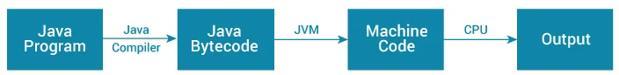
Working Of Your Java Program

Slide 23
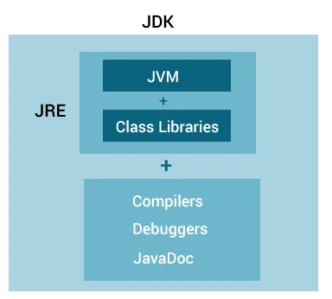
Relationship between JVM, JRE, and JDK.

Slide 24
JVM
The Java Virtual Machine or JVM is a platform-independent Java component that provides an environment for executing Java programs.
So, JVM loads the code, validates the code, executes the code, and provides a runtime environment.

Slide 25
JVM
Java Virtual Machine is a software tool responsible for creating a run-time environment for the Java source code to run. The very powerful feature of Java, "Write once and run anywhere," is made possible by JVM.
The JVM stays right on top of the host operating system and converts the java source code into ByteCode (machine language), and executes the program.

Slide 26
JRE
Java Run-time Environment is a software platform where all the Java Source codes are executed. JRE is responsible for integrating the software plugins, jar files, and support libraries necessary for the source code to run.
We have explored the architecture of JDK in Java, and now we will move ahead and learn more about the components of JDK in Java.

Slide 27
JDK
JDK in Java is an abbreviation for Java Development Kit.
The Java Development Kit or JDK is a superset of JRE and is a software development environment used to develop Java applications and applets.
It is a bundle of software development tools and supporting libraries combined with the Java Runtime Environment (JRE) and Java Virtual Machine (JVM).
We can define the Java Development Kit as a software development environment responsible for creating a run-time environment for the Java source code to run.

Slide 28
To run Java Programs, just the Java Run-time Environment would be enough, but why the complete JDK?
The answer is comparatively simple. Unlike typical Java programs, the real-time Java applications require complex software toolkits and libraries available only in JDK.

Slide 29
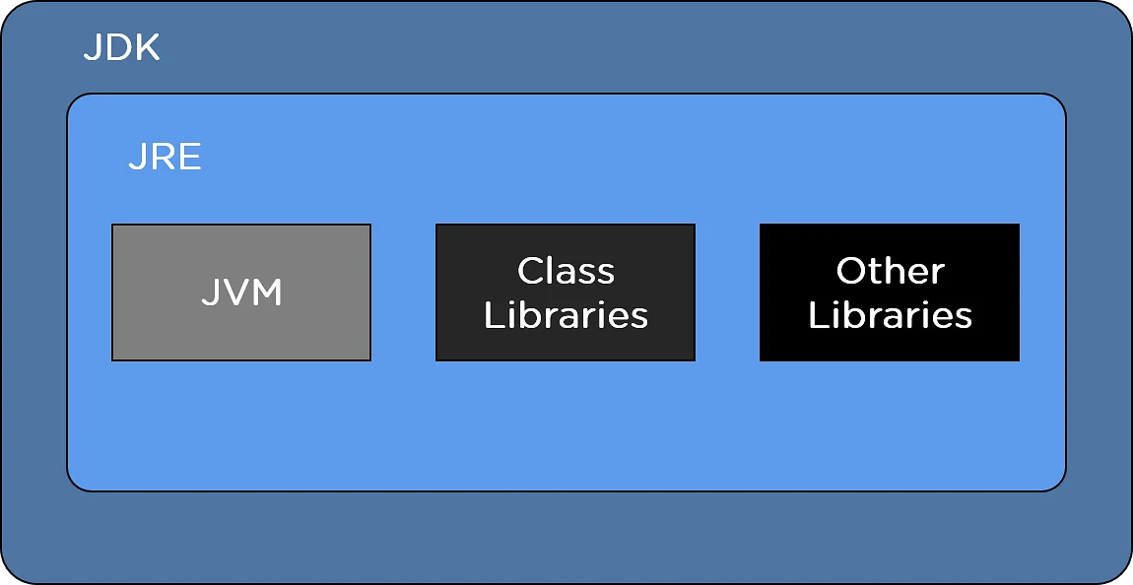
Architecture of JDK in Java

Slide 30

Do you want to run Java™ programs, or do you want to develop Java programs? If you want to run Java programs, but not develop them, download the Java Runtime Environment, or JRE™.
If you want to develop applications for Java, download the Java Development Kit, or JDK™. The JDK includes the JRE, so you do not have to download both separately

Slide 31
Components of JDK in Java

Slide 32
Components of JDK in Java
The fundamental components of JDK in Java are listed below.
java
It acts as the deployment launcher in the older SUN java. It loads the class files and interprets the source code compiled by the javac compiler.
javac
The javac specifies the java compiler to convert the source code into bytecode.
javadoc
The javadoc generates documentation for the comments added in the source code.
jar
The jar helps the archives to manage the jar files in the package library.

Slide 33

Reserved Keyword
Reserved words are words that cannot be used as object or variable names in a Java program because they're already used by the syntax of the Java programming language.
If you attempt to use any of the words below as identifiers in your Java programs, you'll get an error.

Slide 34
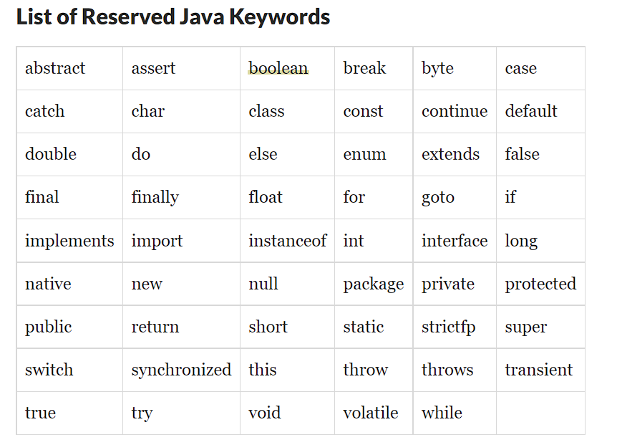
Reserved Keywords

Slide 35
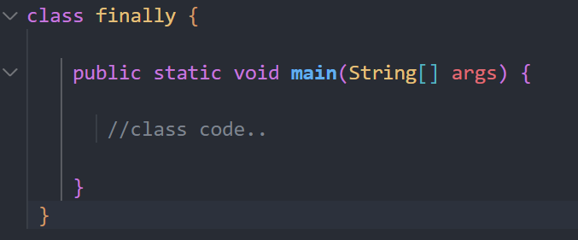
What if we use keyword as className

Slide 36
Variables
A variable is a container which holds the value while the Java programis executed.
A variable is assigned with a data type.
Variable is a name of memory location. There are three types of variables in java: local, instance and static.

Slide 37
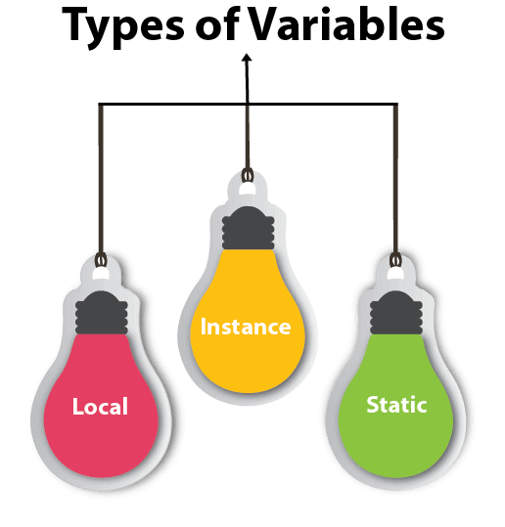
Variables

Slide 38
Local Variable
A variable declared inside the body of the method is called local variable. You can use this variable only within that method and the other methods in the class aren't even aware that the variable exists.
A local variable cannot be defined with "static" keyword.

Slide 39
Instance Variable
A variable declared inside the class but outside the body of the method, is called an instance variable. It is not declared as static
It is called an instance variable because its value is instance-specific and is not shared among instances.

Slide 40

Static variable
A variable that is declared as static is called a static variable. It cannot be local.
You can create a single copy of the static variable and share it among all the instances of the class.
Memory allocation for static variables happens only once when the class is loaded in the memory.

Slide 41
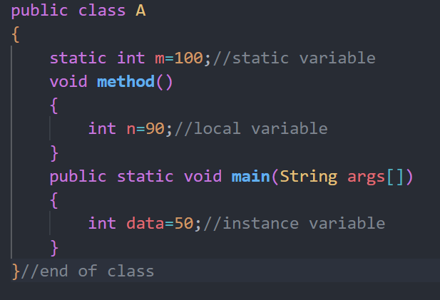
Types of variables in java

Slide 42

Data Types in Java
Data types specify the different sizes and values that can be stored in the variable. There are two types of data types in Java:
Primitive data types: The primitive data types include boolean, char, byte, short, int, long, float and double.
Non-primitive data types: The non-primitive data types include Classes, Interfaces, and Arrays.

Slide 43

Primitive Data Types
There are 8 types of primitive data types:
boolean data type
byte data type
char data type
short data type
int data type
long data type
float data type
double data type

Slide 44
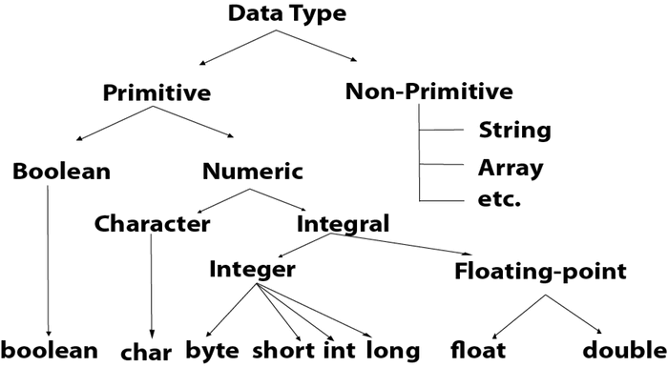
Data-Types

Slide 45
Operators
There are many types of operators in Java which are given below:
Unary Operator,
Arithmetic Operator,
Shift Operator,
Relational Operator,
Bitwise Operator,
Logical Operator,
Ternary Operator and
Assignment Operator.

Slide 46
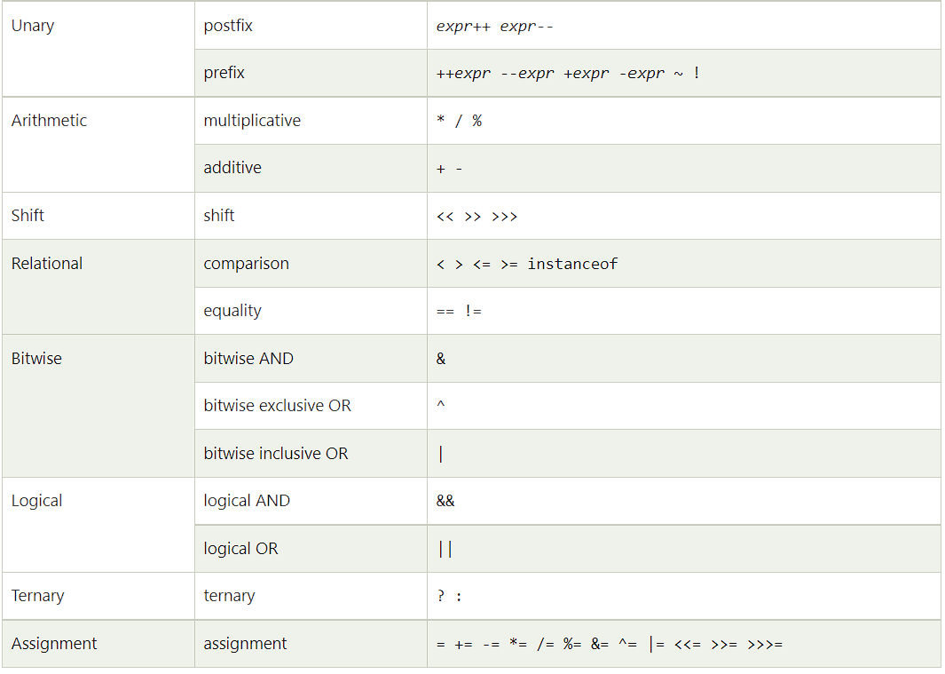

Slide 47
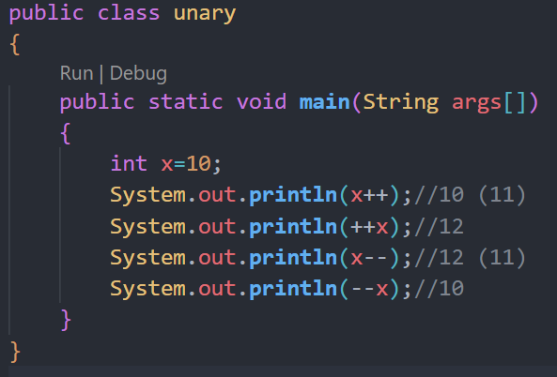
Unary Operator

Slide 48
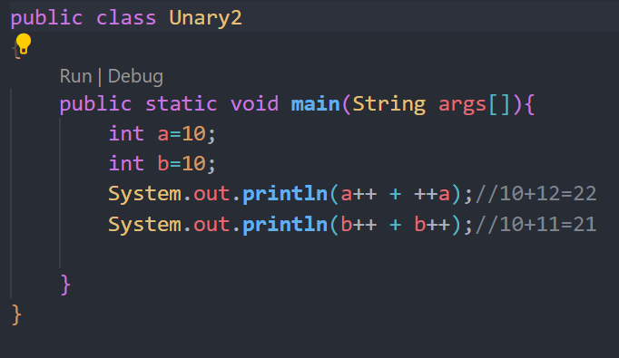
Unary Operator

Slide 49
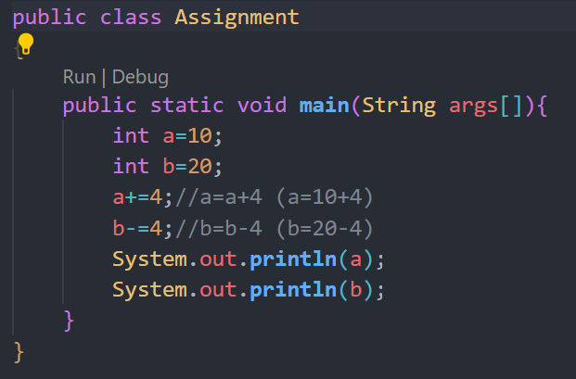
Assignment Operator

Slide 50
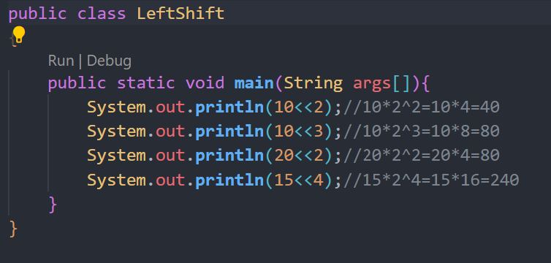
Left-Shift Operator

Slide 51
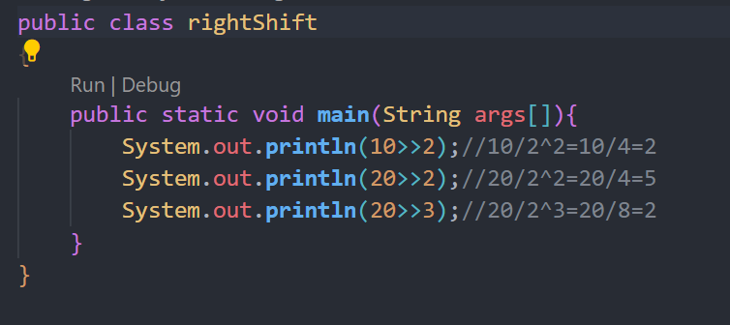
Right-Shift Operator

Slide 52
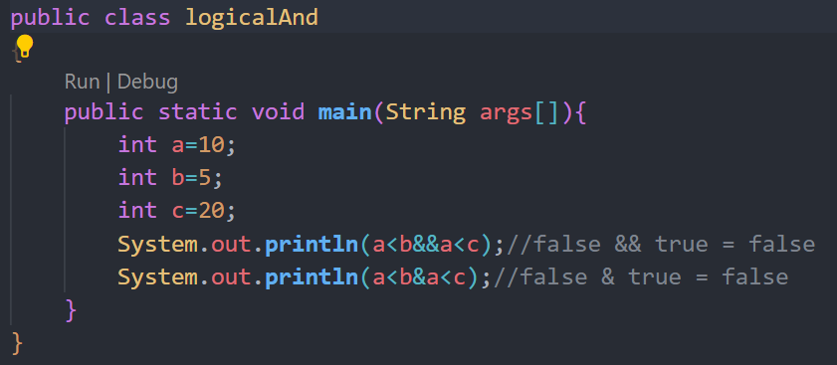
Logical-and (&&)

Slide 53
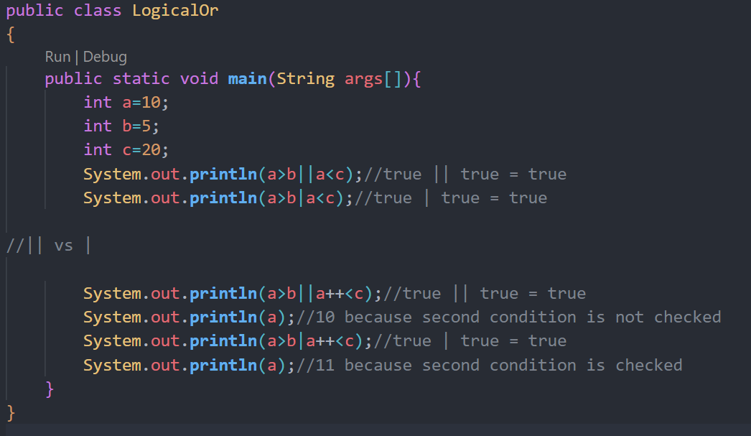
Logical-Or (||)

Slide 54
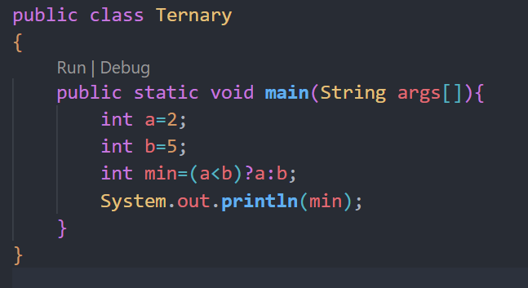
Ternary Operator

Slide 55
Control Statements | Control Flow in Java
Java compiler executes the code from top to bottom. The statements in the code are executed according to the order in which they appear.
However, Java provides statements that can be used to control the flow of Java code. Such statements are called control flow statements.
It is one of the fundamental features of Java, which provides a smooth flow of program.

Slide 56
Types of control flow statements.
Decision Making statements
if statements
switch statement
Loop statements
do while loop
while loop
for loop
for-each loop
Jump statements
break statement
continue statement

Slide 57

If Statement
there are four types of if-statements
Simple if statement
if-else statement
if-else-if ladder
Nested if-statement

Slide 58
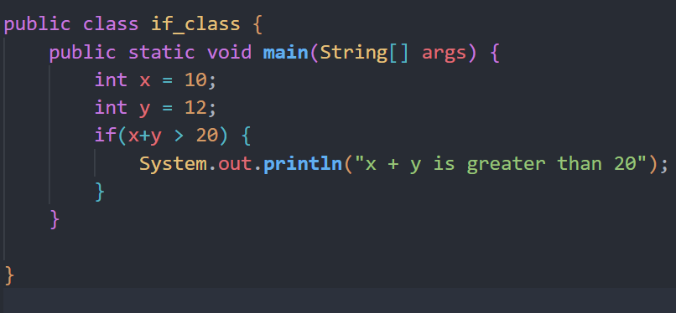
If Statement

Slide 59
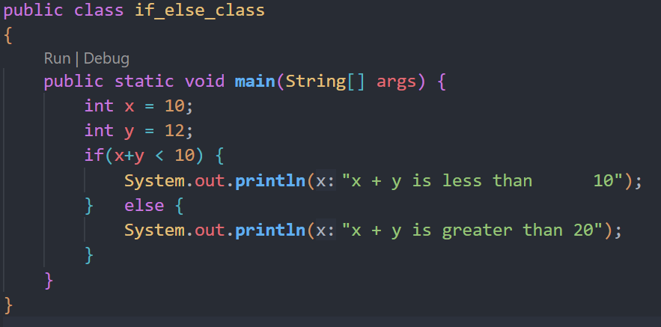
If-else

Slide 60
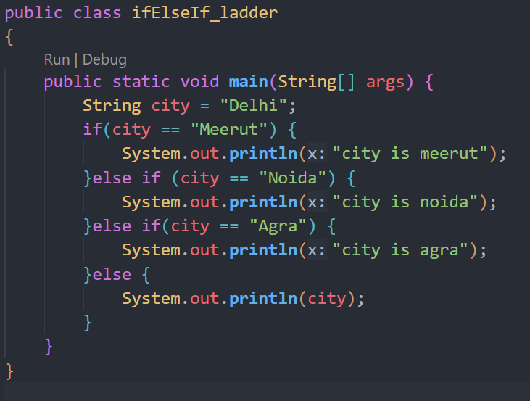
If else If ladder

Slide 61
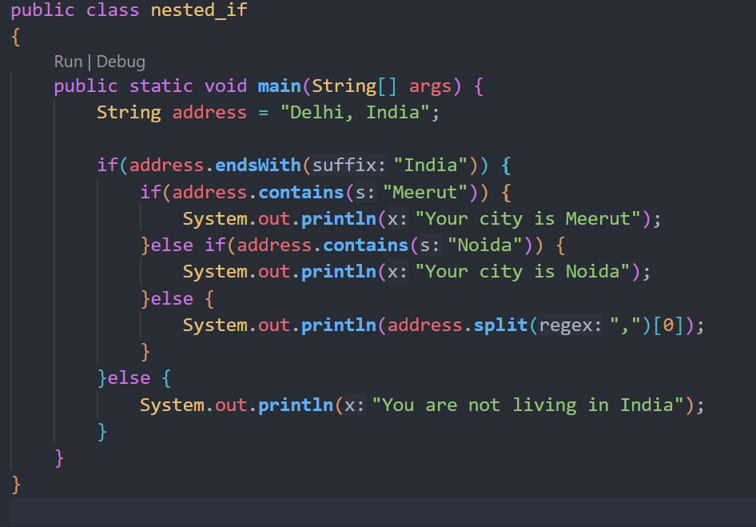
Nested If

Slide 62
Fields
A field is a class, interface, or enum with an associated value. Methods in the java. lang. reflect. Field class can retrieve information about the field, such as its name, type, modifiers, and annotations.
A Java field is a variable inside a class.
For instance, in a class representing an employee, the Employee class might contain the following fields: name position salary hiredDate
The square brackets are declared optional it depends on situation you use for

Slide 63
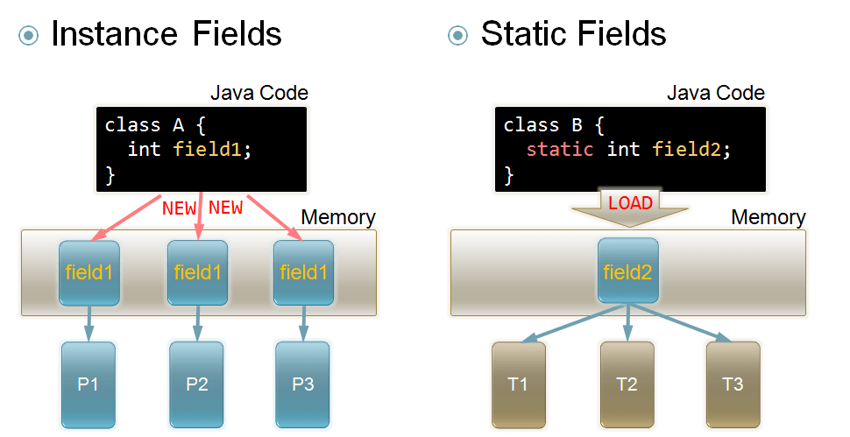
Fields

Slide 64
Methods
A method is a block of code which only runs when it is called.
You can pass data, known as parameters, into a method.
Methods are used to perform certain actions, and they are also known as functions.
Why use methods? To reuse code: define the code once, and use it many times.

Slide 65
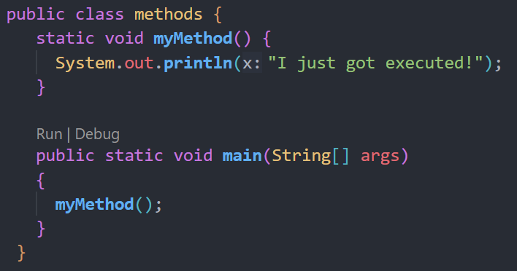
Methods

Slide 66
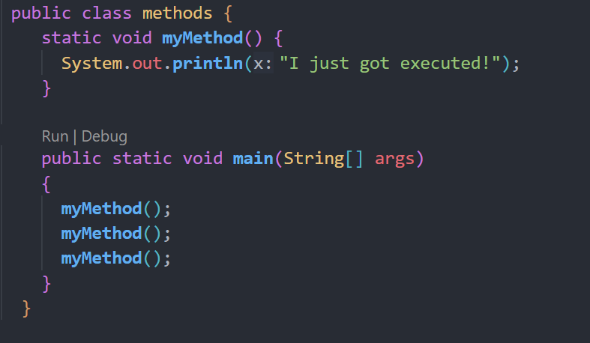
A method can also be called multiple times:

Slide 67
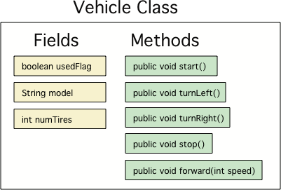
Fields vs Methods

Slide 68
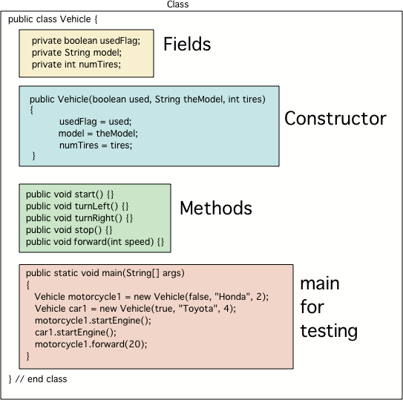

Slide 69
Method Parameters
Information can be passed to methods as parameter. Parameters act as variables inside the method.
Parameters are specified after the method name, inside the parentheses. You can add as many parameters as you want, just separate them with a comma.
The following example has a method that takes a String called fname as parameter. When the method is called, we pass along a first name, which is used inside the method to print the full name

Slide 70
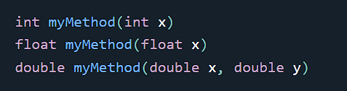
Overloading
With method overloading, multiple methods can have the same name with different parameters

Slide 71
Scope
variables are only accessible inside the region they are created.
Variables declared directly inside a method are available anywhere in the method following the line of code in which they were declared

Slide 72
Block Scope
block of code refers to all of the code between curly braces {}.
Variables declared inside blocks of code are only accessible by the code between the curly braces, which follows the line in which the variable was declared

Slide 73
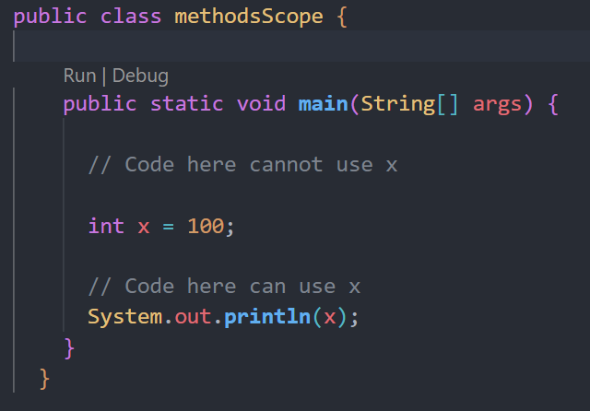
Block Scope

Slide 74
Recursion
Recursion is the technique of making a function call itself.
This technique provides a way to break complicated problems down into simple problems which are easier to solve.

Slide 75
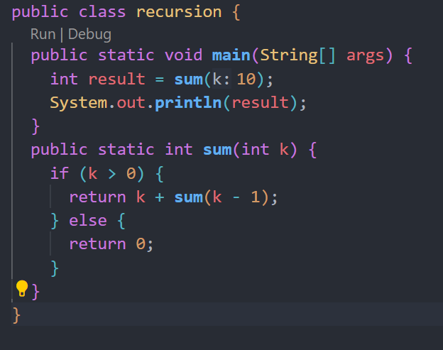
Recursion

Slide 76

Java Classes/Objects

Slide 77
Create an Object
In Java, an object is created from a class. We have already created the class named Main, so now we can use this to create objects.
To create an object of Main, specify the class name, followed by the object name, and use the keyword new

Slide 78
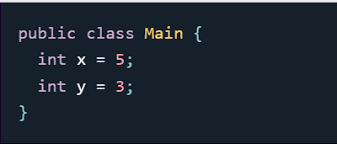
Attributes
In the previous chapter, we used the term "variable" for x in the example (as shown below).
It is actually an attribute of the class. Or you could say that class attributes are variables within a class

Slide 79
Accessing Attributes
You can access attributes by creating an object of the class, and by using the dot syntax (.).
The following example will create an object of the Main class, with the name myObj. We use the x attribute on the object to print its value

Slide 80

Modify Attributes

Slide 81
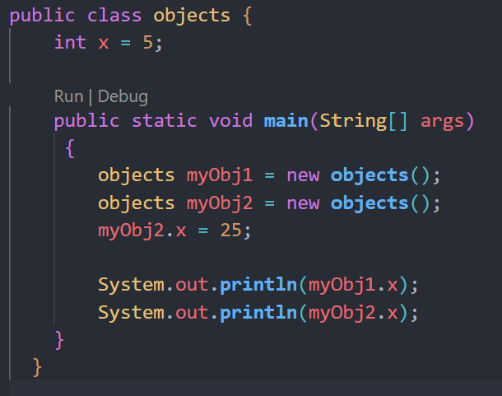
Multiple Objects
If you create multiple objects of one class, you can change the attribute values in one object, without affecting the attribute values in the other

Slide 82
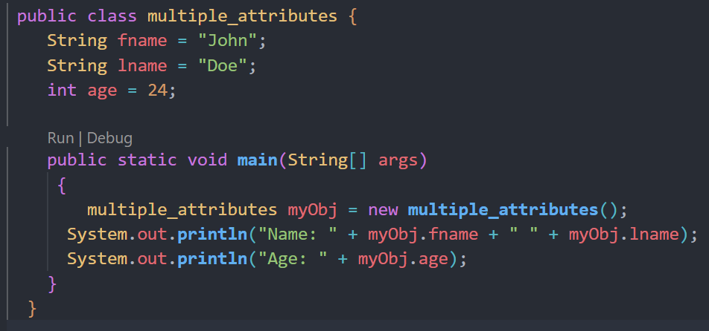
Multiple Attributes
You can specify as many attributes as you want:

Slide 83

Static vs. Public
You will often see Java programs that have either static or public attributes and methods.
In the example above, we created a static method, which means that it can be accessed without creating an object of the class, unlike public, which can only be accessed by objects

Slide 84

Access Methods With an Object
Create a Car object named myCar. Call the fullThrottle() and speed() methods on the myCar object, and run the program

Slide 85

Remember
The dot (.) is used to access the object's attributes and methods.
To call a method in Java, write the method name followed by a set of parentheses (), followed by a semicolon (;).
A class must have a matching filename (Main and Main.java).

Slide 86
Using Multiple Classes
it is a good practice to create an object of a class and access it in another class.
Remember that the name of the java file should match the class name. In this example, we have created two files in the same directory:
Main.java
Second.java

Slide 87
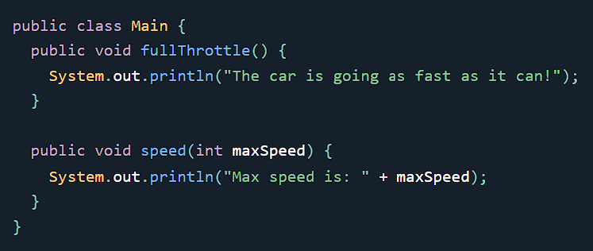
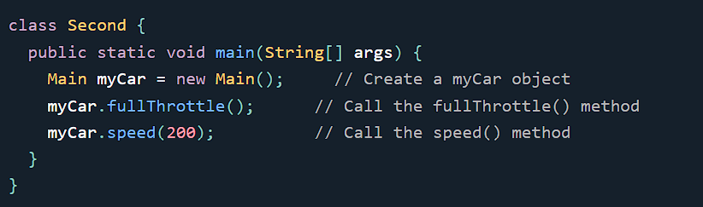

Slide 88
Constructors
A constructor in Java is a special method that is used to initialize objects. The constructor is called when an object of a class is created.
It can be used to set initial values for object attributes

Slide 89

Remember
Note that the constructor name must match the class name, and it cannot have a return type (like void).
Also note that the constructor is called when the object is created.
All classes have constructors by default: if you do not create a class constructor yourself, Java creates one for you. However, then you are not able to set initial values for object attributes.

Slide 90

Modifiers
The public keyword is an access modifier, meaning that it is used to set the access level for classes, attributes, methods and constructors.
We divide modifiers into two groups:
Access Modifiers - controls the access level
Non-Access Modifiers - do not control access level, but provides other functionality

Slide 91
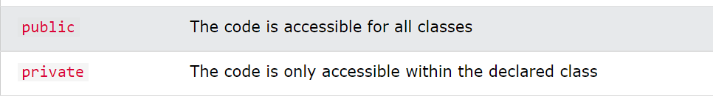
For classes, you can use either public or default

Slide 92
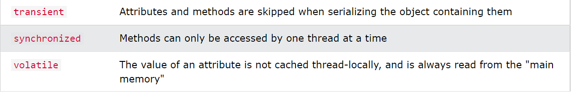
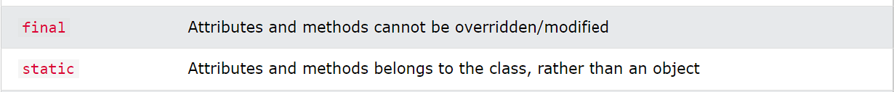
Non-Access Modifiers
Abstract: Can only be used in an abstract class, and can only be used on methods. The method does not have a body, for example abstract void run();. The body is provided by the subclass (inherited from)

Slide 93
Encapsulation
The meaning of Encapsulation, is to make sure that "sensitive" data is hidden from users. To achieve this, you must:
declare class variables/attributes as private
provide public get and set methods to access and update the value of a private variable

Slide 94
Get and Set
private variables can only be accessed within the same class (an outside class has no access to it). However, it is possible to access them if we provide public get and set methods.
The get method returns the variable value, and the set method sets the value.

Slide 95
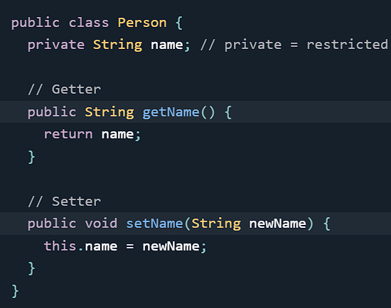
Get and Set

Slide 96

Why Encapsulation?
Better control of class attributes and methods
Class attributes can be made read-only (if you only use the get method), or write-only (if you only use the set method)
Flexible: the programmer can change one part of the code without affecting other parts
Increased security of data

Slide 97

Java Packages & API
A package in Java is used to group related classes. Think of it as a folder in a file directory. We use packages to avoid name conflicts, and to write a better maintainable code. Packages are divided into two categories:
Built-in Packages (packages from the Java API)
User-defined Packages (create your own packages)

Slide 98
Built-in Packages
The Java API is a library of prewritten classes, that are free to use, included in the Java Development Environment.
The library contains components for managing input, database programming, and much much more.
The library is divided into packages and classes. Meaning you can either import a single class (along with its methods and attributes), or a whole package that contain all the classes that belong to the specified package.
To use a class or a package from the library, you need to use the import keyword

Slide 99
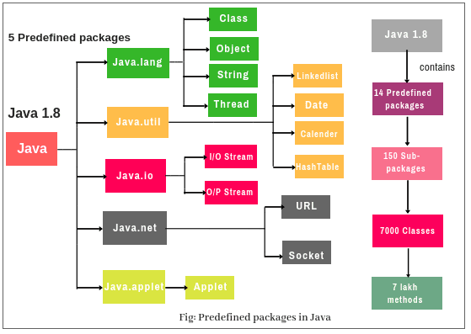

Slide 100
Import a Package
There are many packages to choose from. In the previous example, we used the Scanner class from the java.util package. This package also contains date and time facilities, random-number generator and other utility classes.
To import a whole package, end the sentence with an asterisk sign (*). The following example will import ALL the classes in the java.util package
import java.util.*;

Slide 101

Inheritance (Subclass and Superclass)
In Java, it is possible to inherit attributes and methods from one class to another. We group the "inheritance concept" into two categories:
subclass (child) - the class that inherits from another class
superclass (parent) - the class being inherited from
To inherit from a class, use the extends keyword.
In the example below, the Car class (subclass) inherits the attributes and methods from the Vehicle class (superclass):

Slide 102
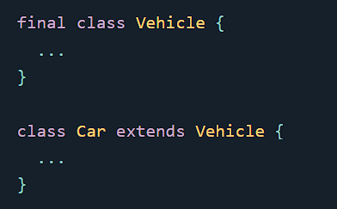
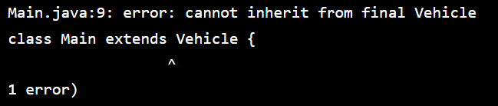
The final Keyword
If you try to access a final class, Java will generate an error:

Slide 103

Polymorphism
Polymorphism means "many forms", and it occurs when we have many classes that are related to each other by inheritance.
Polymorphism uses those methods to perform different tasks. This allows us to perform a single action in different ways.
Remember from the Inheritance that we use the extends keyword to inherit from a class.

Slide 104

Remember
In inheritance,
we create new classes that inherit features of the superclass while polymorphism decides what form of method to execute
. Inheritance applies to classes, whereas polymorphism applies to methods.

Slide 105
Inner Classes
In Java, it is also possible to nest classes (a class within a class). The purpose of nested classes is to group classes that belong together, which makes your code more readable and maintainable.
To access the inner class, create an object of the outer class, and then create an object of the inner class

Slide 106
Private Inner Class
Unlike a "regular" class, an inner class can be private or protected.
If you don't want outside objects to access the inner class, declare the class as private

Slide 107

Static Inner Class
An inner class can also be static, which means that you can access it without creating an object of the outer class

Slide 108
Access Outer Class From Inner Class
One advantage of inner classes, is that they can access attributes and methods of the outer class

Slide 109

Abstraction
Data abstraction is the process of hiding certain details and showing only essential information to the user. Abstraction can be achieved with either abstract classes or interfaces
The abstract keyword is a non-access modifier, used for classes and methods:

Slide 110
Abstraction
Abstract class: is a restricted class that cannot be used to create objects (to access it, it must be inherited from another class)
Abstract method: can only be used in an abstract class, and it does not have a body. The body is provided by the subclass (inherited from).
An abstract class can have both abstract and regular methods

Slide 111

Why And When To Use Abstract Classes and Methods?
To achieve security - hide certain details and only show the important details of an object.
Note: Abstraction can also be achieved with Interfaces,

Slide 112
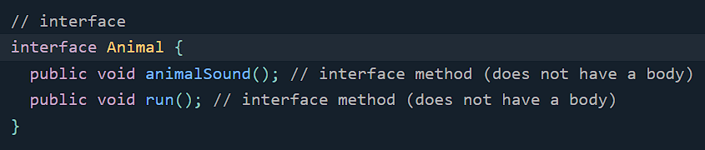
Interface
Another way to achieve abstraction in Java, is with interfaces.
An interface is a completely "abstract class" that is used to group related methods with empty bodies

Slide 113
Interface
To access the interface methods, the interface must be "implemented" (kinda like inherited) by another class with the implements keyword (instead of extends).
The body of the interface method is provided by the "implement" class

Slide 114
Note:
Like abstract classes, interfaces cannot be used to create objects
Interface methods do not have a body - the body is provided by the "implement" class
On implementation of an interface, you must override all of its methods
Interface methods are by default abstract and public
Interface attributes are by default public, static and final
An interface cannot contain a constructor (as it cannot be used to create objects)

Slide 115
Why And When To Use Interfaces?
1) To achieve security - hide certain details and only show the important details of an object (interface).
2) Java does not support "multiple inheritance" (a class can only inherit from one superclass).
However, it can be achieved with interfaces, because the class can implement multiple interfaces.
Note: To implement multiple interfaces, separate them with a comma

Slide 116

Multiple Interfaces

Slide 117
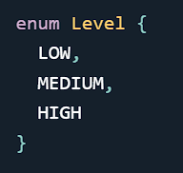
Enums
An enum is a special "class" that represents a group of constants (unchangeable variables, like final variables).
To create an enum, use the enum keyword (instead of class or interface), and separate the constants with a comma. Note that they should be in uppercase letters
Enum is short for "enumerations", which means "specifically listed"

Slide 118

Enum vs Class
An enum can, just like a class, have attributes and methods. The only difference is that enum constants are public, static and final (unchangeable - cannot be overridden).
An enum cannot be used to create objects, and it cannot extend other classes (but it can implement interfaces).

Slide 119

When To Use Enums?
Use enums when you have values that you know aren't going to change, like month days, days, colors, deck of cards, etc.

Slide 120
User Input (Scanner)
The Scanner class is used to get user input, and it is found in the java.util package.
To use the Scanner class, create an object of the class and use any of the available methods found in the Scanner class documentation. In our example, we will use the nextLine() method, which is used to read Strings

Slide 121
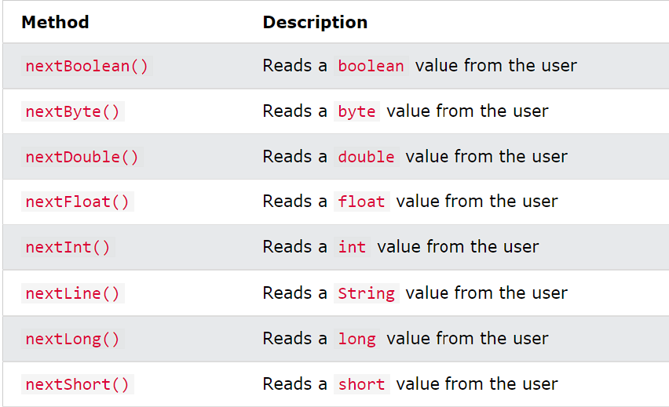
Input Types
If you enter wrong input (e.g. text in a numerical input), you will get an exception/error message (like "InputMismatchException").

Slide 122

Exceptions
When executing Java code, different errors can occur: coding errors made by the programmer, errors due to wrong input, or other unforeseeable things.
When an error occurs, Java will normally stop and generate an error message. The technical term for this is: Java will throw an exception (throw an error)

Slide 123
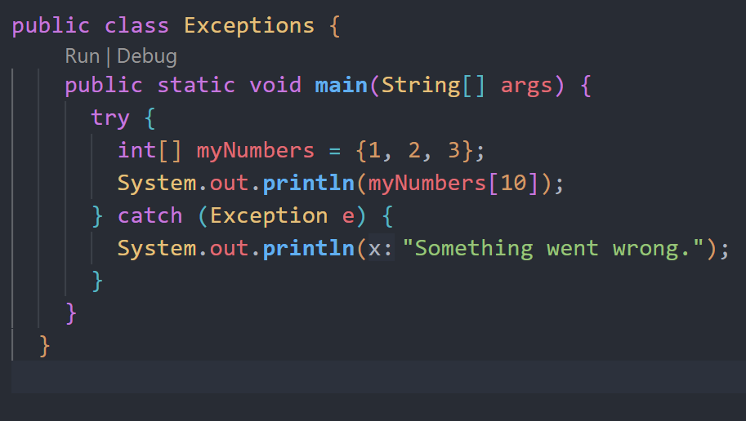
Exceptions

Slide 124
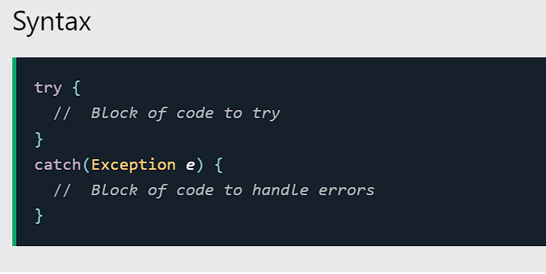
Java try and catch
The try statement allows you to define a block of code to be tested for errors while it is being executed.
The catch statement allows you to define a block of code to be executed, if an error occurs in the try block.
The try and catch keywords come in pairs

Slide 125
Finally
The finally statement lets you execute code, after try...catch, regardless of the result

Slide 126
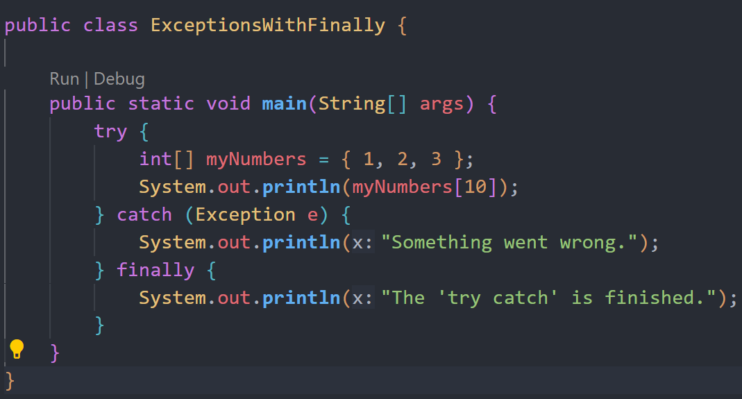
Finally

Slide 127
The throw keyword
The throw statement allows you to create a custom error.
The throw statement is used together with an exception type. There are many exception types available in Java: ArithmeticException, FileNotFoundException, ArrayIndexOutOfBoundsException, SecurityException, etc:

Slide 128
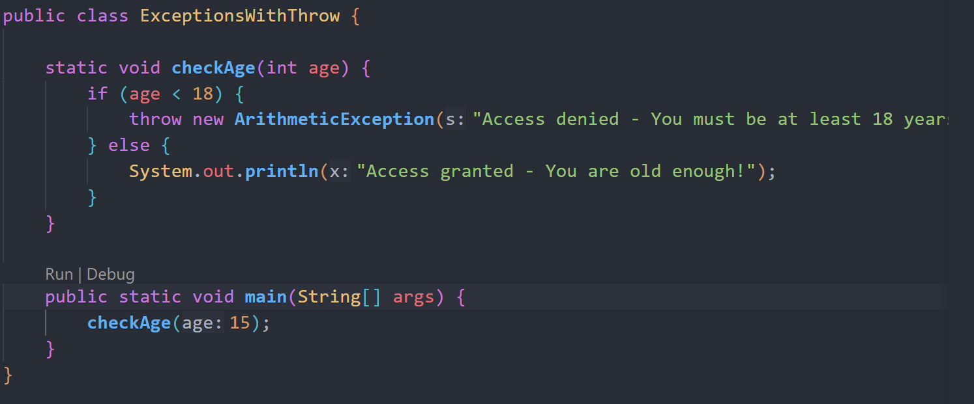
Throw Keyword

Slide 129

GoodLuck !!

Slide 130
Thank You !!

